Slide 1
Theory of the 3x3 Cube
COLL 134
Week 1

Slide 2
Course Overview
Syllabus details

Slide 3
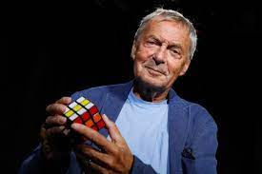
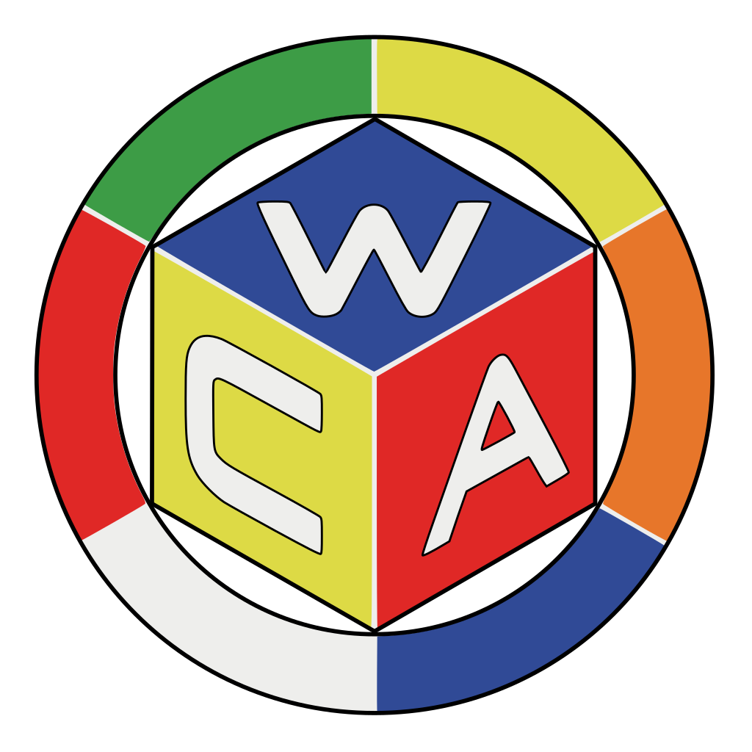
History
Invented by Hungarian architect Ernő Rubik in 1974
1975 patent – “Magic Cube”
2 major bursts of popularity:
1980s – mainstream popularity
Estimated 100s of millions of cubes sold
2000s-2010s – “competitive/speedsolving” popularity
Establishment of World Cube Association to govern competitions and official records
Many advancements in improving cube mechanism and build quality

Slide 4
Quotes from Rubik
Interview with Rubik on how he conceptualized the puzzle:
The little cube that changed the world | CNN Business
“I believe probably the most characteristic part of the cube is the contradiction between simplicity and complexity.”

Slide 5
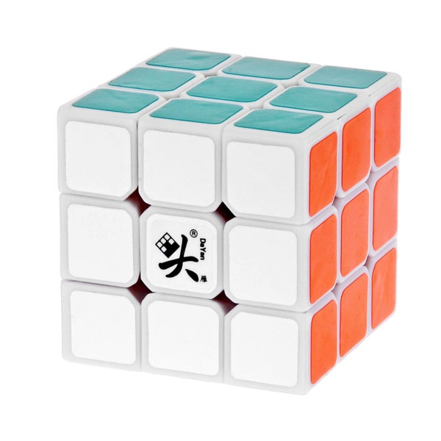
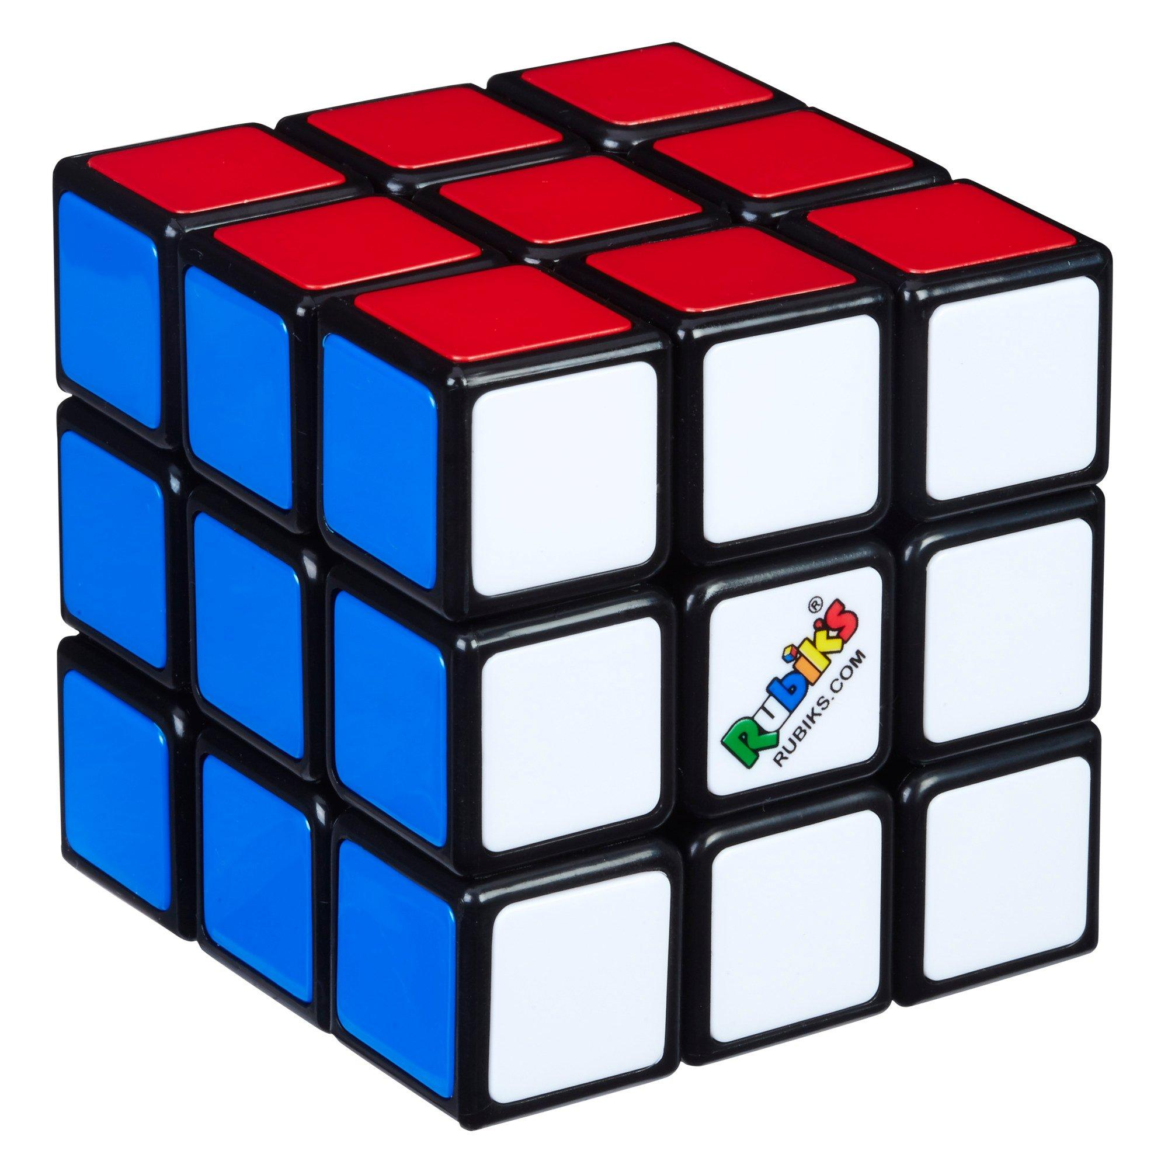
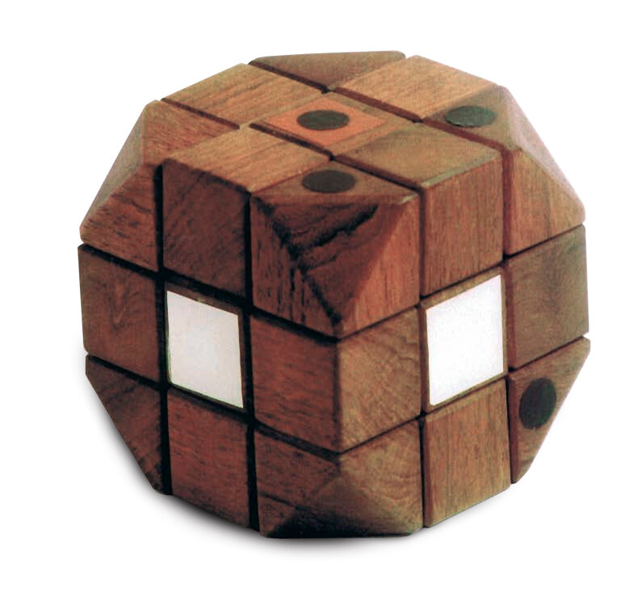
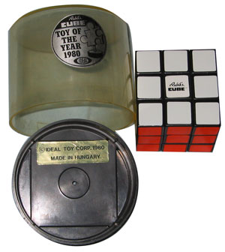
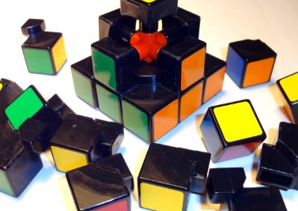
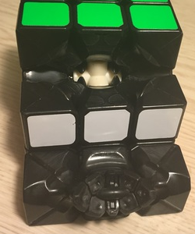
Rubik’s Cube Evolution
Dayan ZhanChi, 2011, one of the most popular speedcubes of all time
Standard “Rubik’s brand” cube
Blocky design
Slimmer design
Erno Rubik’s wooden prototype
Ideal Toy Corp, 1980, Hungary

Slide 6
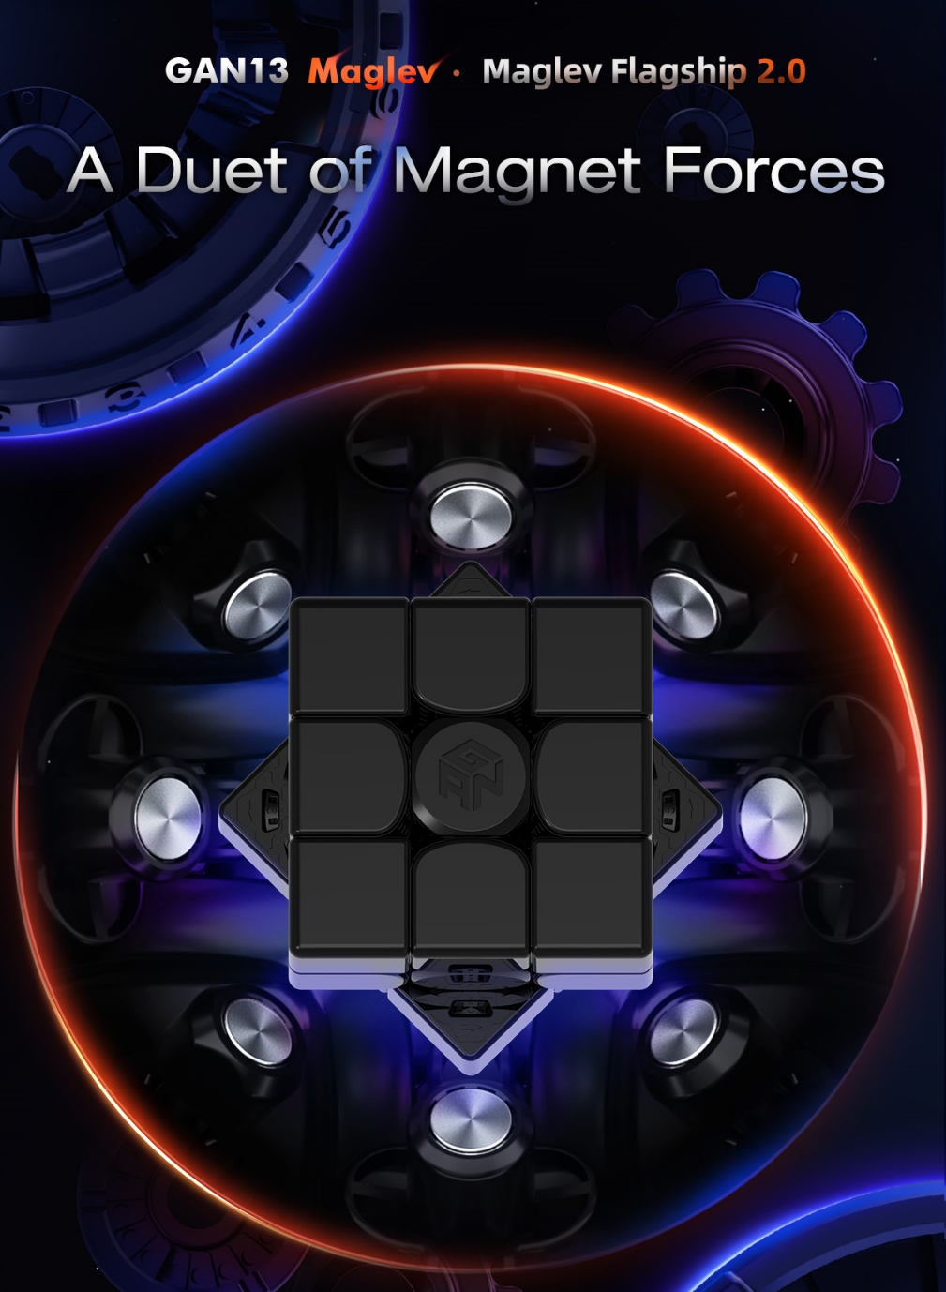
“Modern Rubik’s Cubes”
GAN 13 by GANCube
the Ferrari/Rolex/Chanel of 3x3 cubes

Slide 7
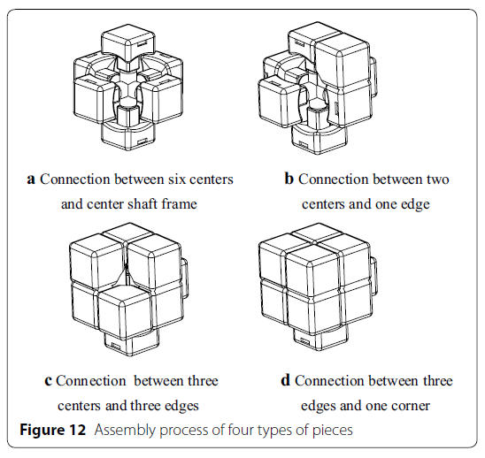
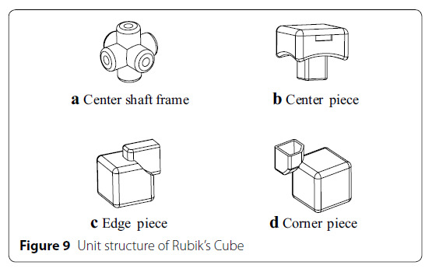
Structure/Construction of the 3x3
Zeng et al. 2018

Slide 8
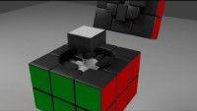
Structure/Construction Animation
Jared Owen Animations

Slide 9
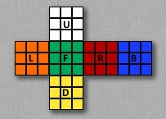
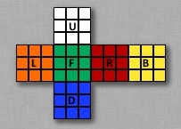
External Details
Western (most common)
Typically, 55-57 mm edge lengths
Western color scheme:
White opposite Yellow
White + Yellow = Yellow
Red opposite Orange
Red + Yellow = Orange
Blue opposite Green
Blue + Yellow = Green
Japanese (rarely used today)

Slide 10
Quotes from Rubik
Why these six colors?
"If the cube wouldn't be colored there would be no objective, there would be nothing to solve. Using the colors we can specify the target we have to reach. I was looking for the most simple way to mark the solved state. I chose these six colors (actually 5 real colors because we don't really call white a color) because they are all basic colors and there's no need to explain them. Everybody knows what red, blue, yellow, green, orange and white are."

Slide 11
Possible Permutations of the 3x3
Total permutations reachable via disassembly and reassembly
= 519,024,039,293,878,272,000
Total permutations reachable via legal moves
= 43,252,003,274,489,856,000

Slide 12
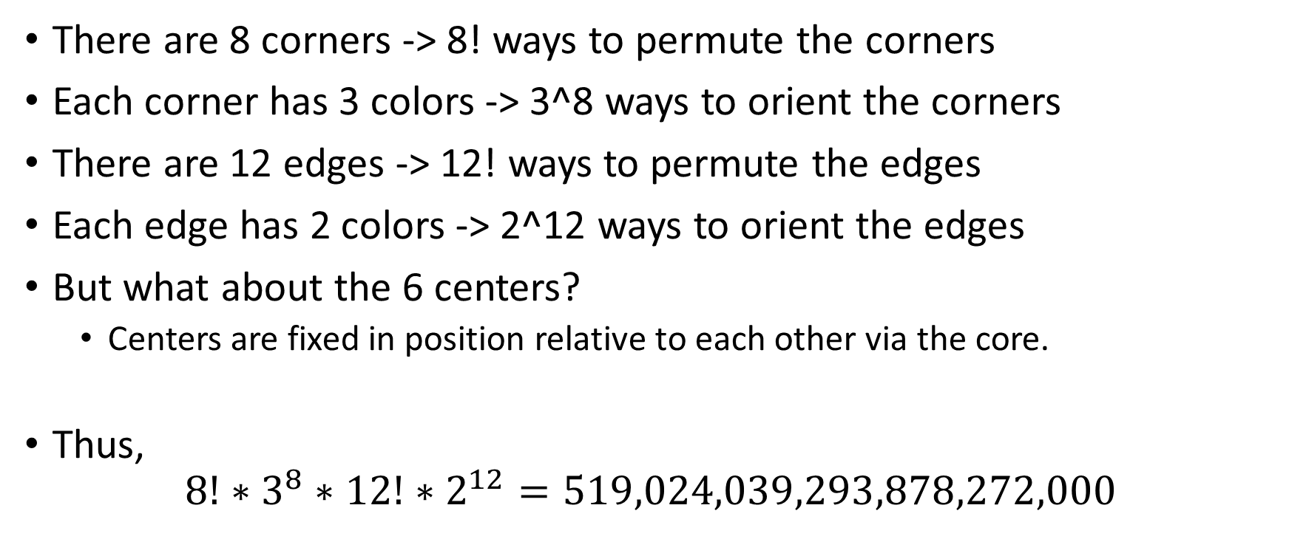
The Math
There are 8 corners -> 8! ways to permute the corners
Each corner has 3 colors -> 3^8 ways to orient the corners
There are 12 edges -> 12! ways to permute the edges
Each edge has 2 colors -> 2^12 ways to orient the edges
But what about the 6 centers?
Centers are fixed in position relative to each other via the core.
Thus,
$$8!∗3^{8}∗12!∗2^{12}=519,024,039,293,878,272,000$$

Slide 13
But…
Why are there more permutations from disassembly than from legal moves?
Most permutations (11/12 to be exact) are impossible to reach using only legal moves.
The orientation of the 8th corner depends on the preceding 7 corners.
Thus, 3^8 becomes 3^7
The orientation of the 12th edge depends on the preceding 11 edges.
Thus, 2^12 becomes 2^11
It is impossible to independently swap/permute just 2 pieces while preserving their original orientations.
Thus, divide the entire expression by 2

Slide 14
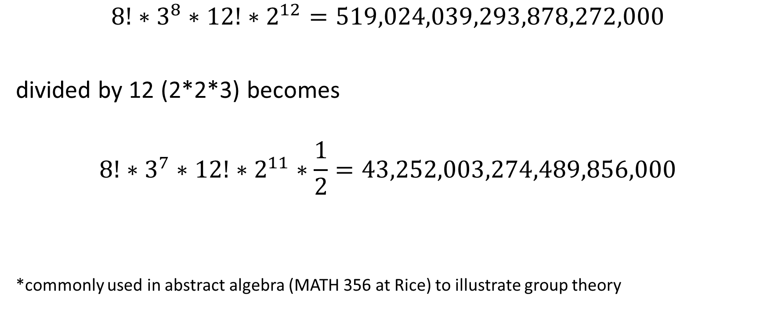
More Math
$$8!∗3^{8}∗12!∗2^{12}=519,024,039,293,878,272,000$$
divided by 12 (2*2*3) becomes
$$8!∗3^{7}∗12!∗2^{11}∗\frac{1}{2}=43,252,003,274,489,856,000$$
*commonly used in abstract algebra (MATH 356 at Rice) to illustrate group theory

Slide 15
3x3 Solution Methods
Many different ways to solve the Rubik’s Cube
First corners, then edges (or vice versa)
Blockbuilding
Layer by layer
The earliest solution methods were completely intuitive. Then, as more people began analyzing the Rubik’s Cube, solution methods started becoming more complex, structured, and dependent on algorithms.

Slide 16
3x3 Notation
How to communicate puzzle solutions/manipulations?
Need to be concise and consistent
Solution: create system of notation

Slide 17
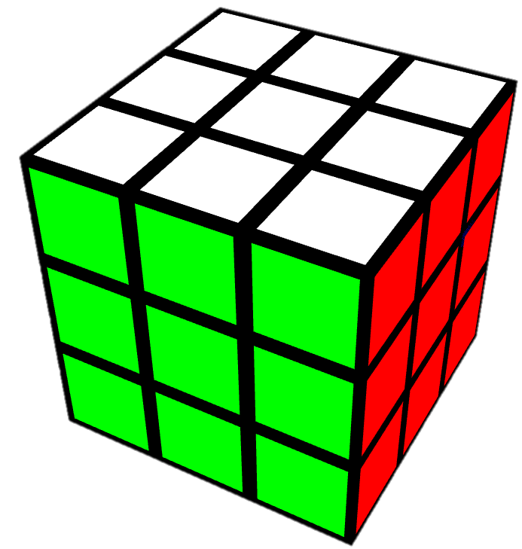
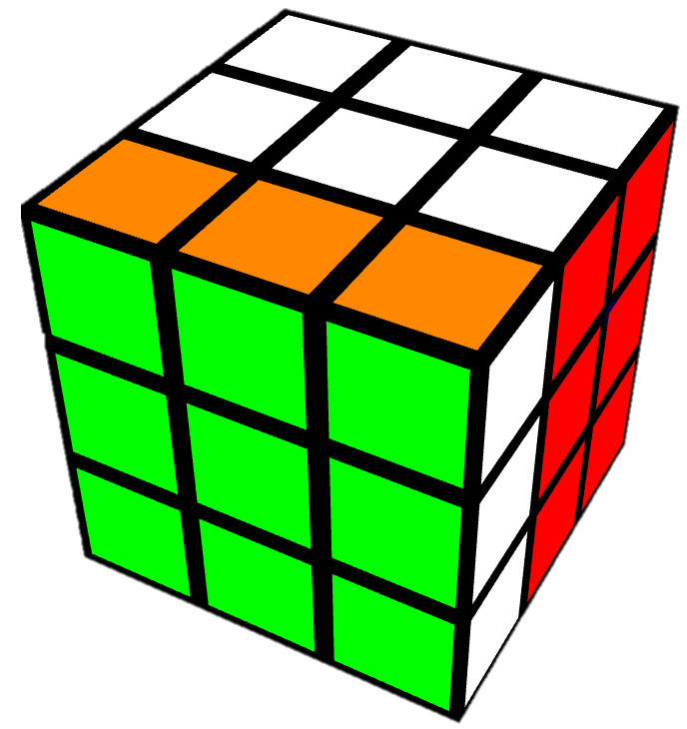
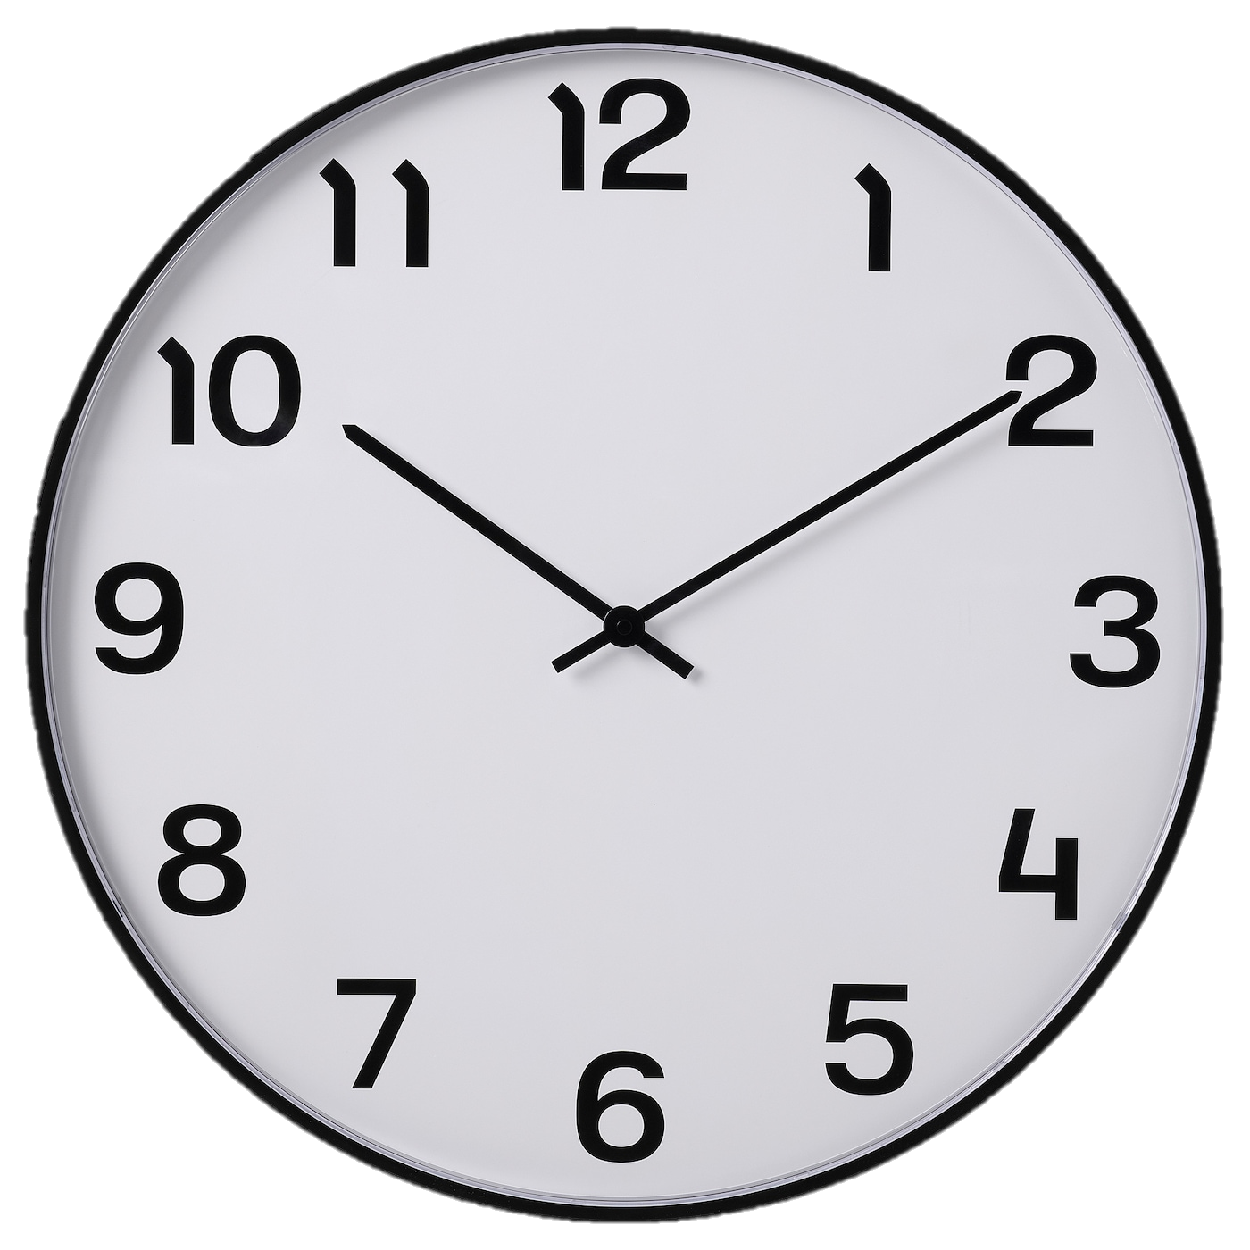
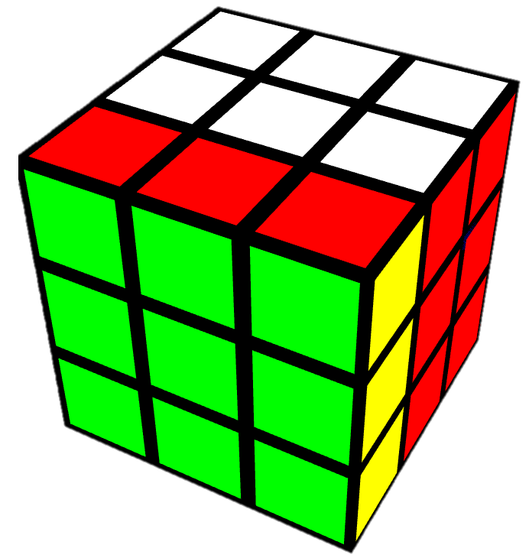
3x3 Notation – Directionality
Clockwise (CW)
Turns
Counter-Clockwise (CCW)
Turns

Slide 18
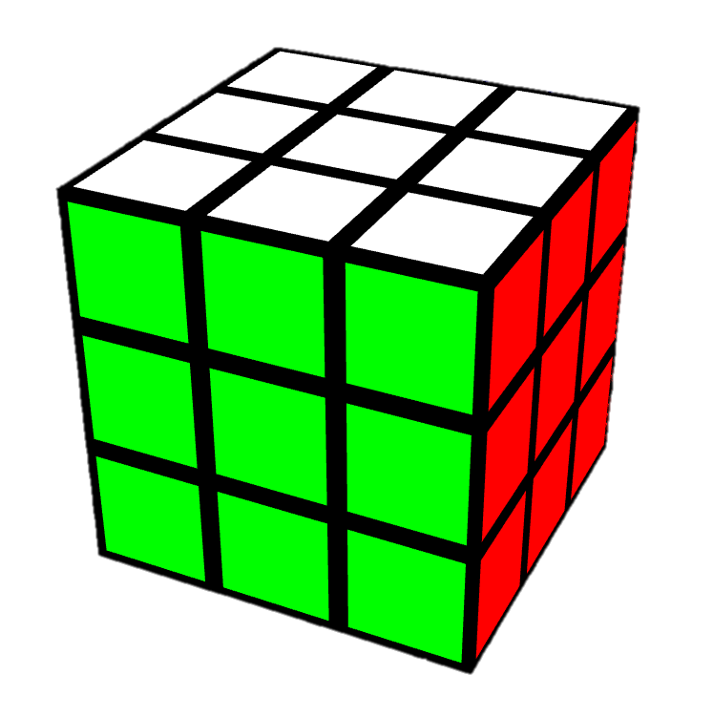
3x3 Notation – Face Turns
Up/Top
Back
Modifiers
U = up face 90° CW
U’ = up face 90° CCW
U2 = up face 180°
Left
Right
Front
Down/Bottom

Slide 19
3x3 Notation – Wide Turns
Up/Top
Back
Option 1: Use lowercase letters instead
Option 2: Add w after letter
“u” or “Uw”
Otherwise, same notation as single-layer face turns
Left
Right
Front
Down/Bottom

Slide 20
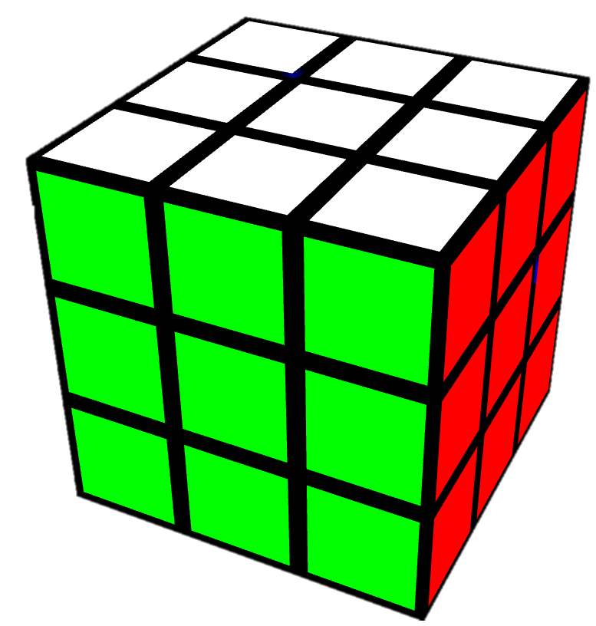
3x3 Notation – Rotations
x-axis
Same direction as R
y-axis
Same direction as U
z-axis
Same direction as F

Slide 21
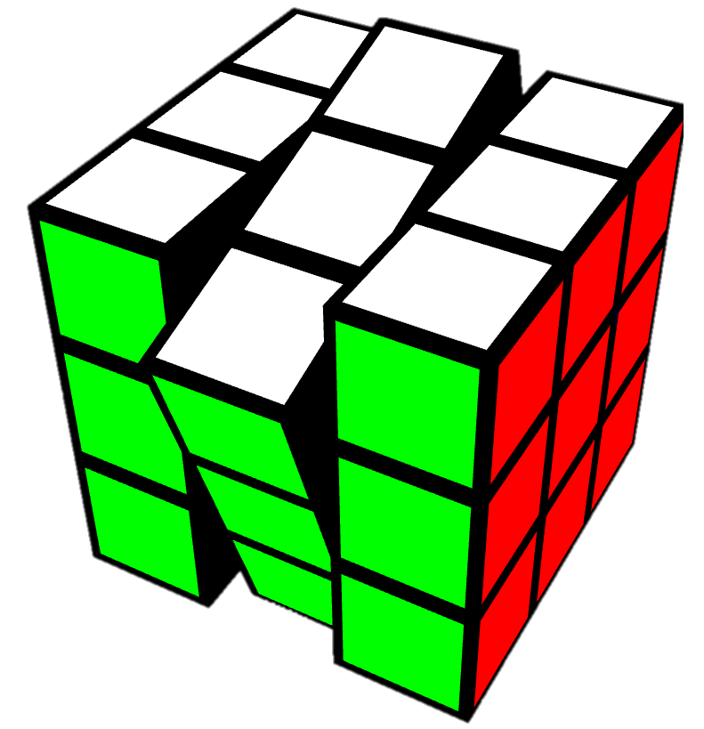
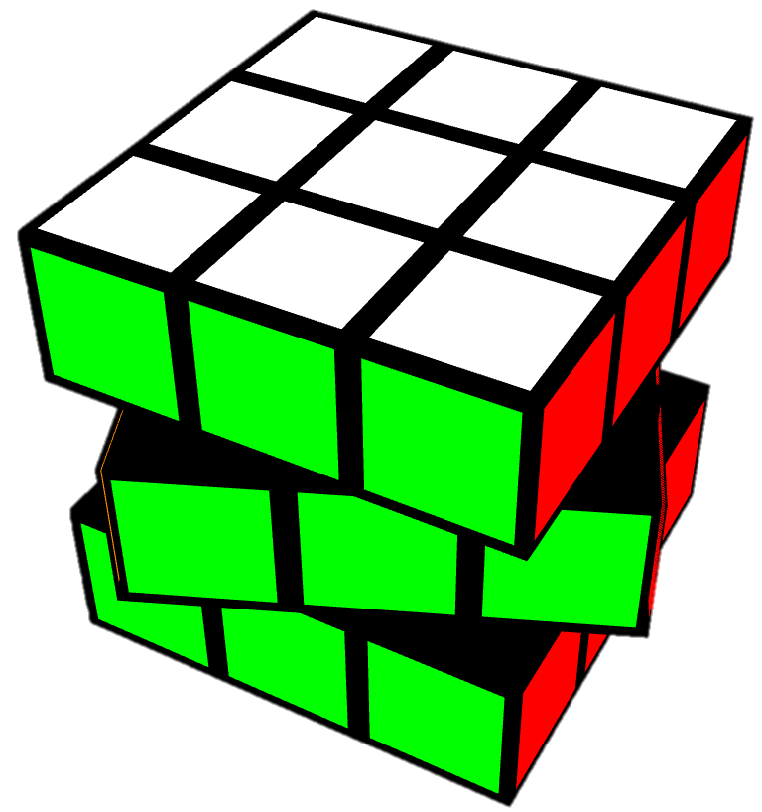
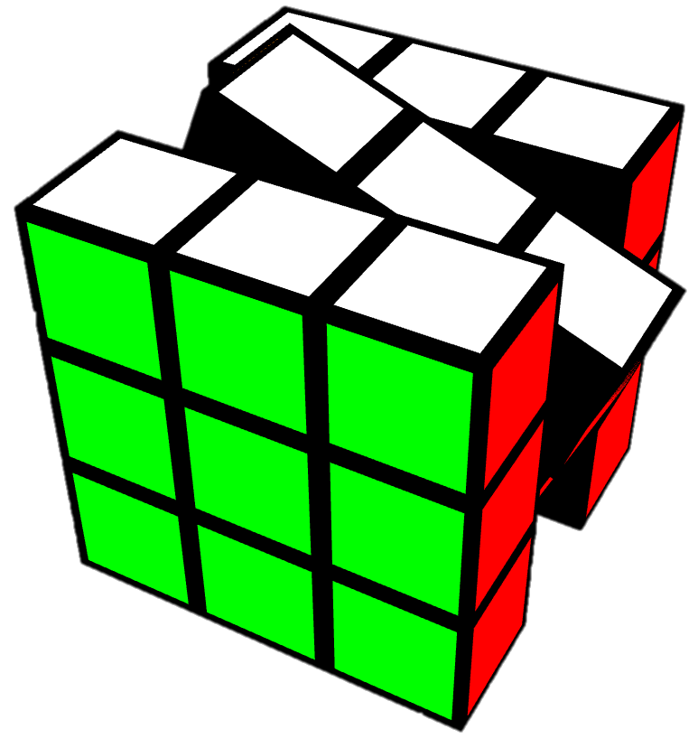
3x3 Notation – Slice Turns
Middle
Same direction as L
Equatorial
Same direction as D
Standing
Same direction as F

Slide 22
Redundant Notation
Multiple ways to indicate a move!
Examples:
U2 = U2’
U3 = U’
U4 = doing nothing
M = L’ R x’
u/Uw = D y
x = R M’ L’

Slide 23
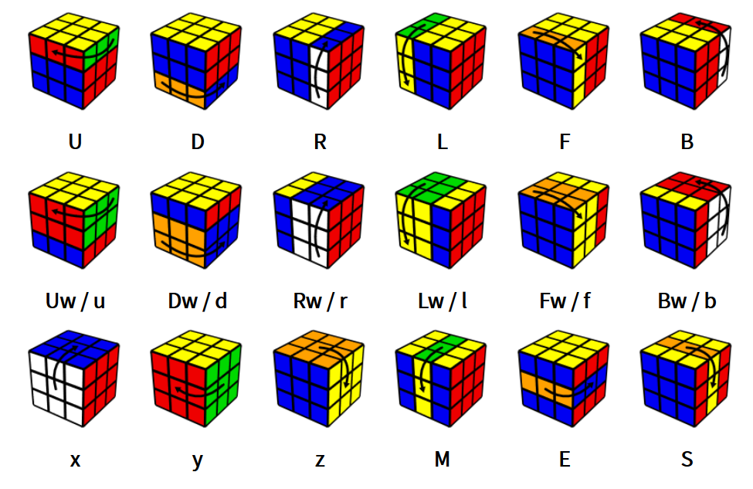
jperm.net

